Slide 1
Constructor overloading and Constructor chaining
Session-11

Slide 2
Session Outcome
Session Outcome: At the end of this session on Constructor overloading (static polymorphism ) and Constructor chaining .
Students will be able to:
Understand the need for constructor overloading and constructor chaining and apply them

Slide 3
Why constructor overloading ?
Sometimes there is a need of initializing an object in different ways.
This can be done using constructor overloading.
If we want to have different ways of initializing an object using different number of parameters, then we must do constructor overloading .

Slide 4
Constructor Overloading
In Java, a constructor is just like a method but without return type.
It can also be overloaded like Java methods.
Constructor overloading in Java is a technique of having more than one constructor with different parameter lists. They are arranged in a way that each constructor performs a different task. They are differentiated by the compiler by the number of parameters in the list and their types.

Slide 5
Example of constructor overloading
Class Demo
{
private int num1;
String name;
Demo(int i)
{
num1=i;
}
Demo(String s)
{
name=s;
}
Demo(int i, String s)
{
num1=i;
name=s;
}
}

Slide 6
Class Diagram
Demo
- num1: int
+ name: String
+ Demo(i: int)
+ Demo (s: String)
+ Demo (i: int , s: String)

Slide 7
Q1:Overload the Cuboid class with all 3 types of constructors and create 3 objects each invoking a different type of constructor from the main methodofDemoclass.
package p1;
public class ConCuboid
{
private double l,b,h;
public ConCuboid(){
l=b=h=0;
}
public ConCuboid(double le, double br, double he){
l=le;
b=br;
h=he;
}
public ConCuboid(ConCuboid ob){
l=ob.l;
b=ob.b;
h=ob.h;}
public String toString(){
String output="Length = "+l+" Breadth = "+b+" Height = "+h;
return output;}
}

Slide 8
package p1;
public class ConCuboidDemo {
public static void main(String args[])
{
ConCuboid ob[] = new ConCuboid[3];
ob[0] = new ConCuboid();
System.out.println(ob[0]);
ob[1] = new ConCuboid(10,20,5);
System.out.println(ob[1]);
ob[2] = new ConCuboid(ob[1]);
System.out.println(ob[2]);
}
}

Slide 9
Why do we need constructor chaining ?
This process is used when we want to perform multiple tasks in a single constructor rather than creating a code for each task in a single constructor ,we create a separate constructor for each task and make their chain which makes the program more readable.

Slide 10
Constructor chaining
Constructor chaining is the process of calling one constructor from another constructor with respect to current object.
Constructor chaining can be done in two ways:
Within same class: It can be done using this() keyword for constructors in same class

Slide 11
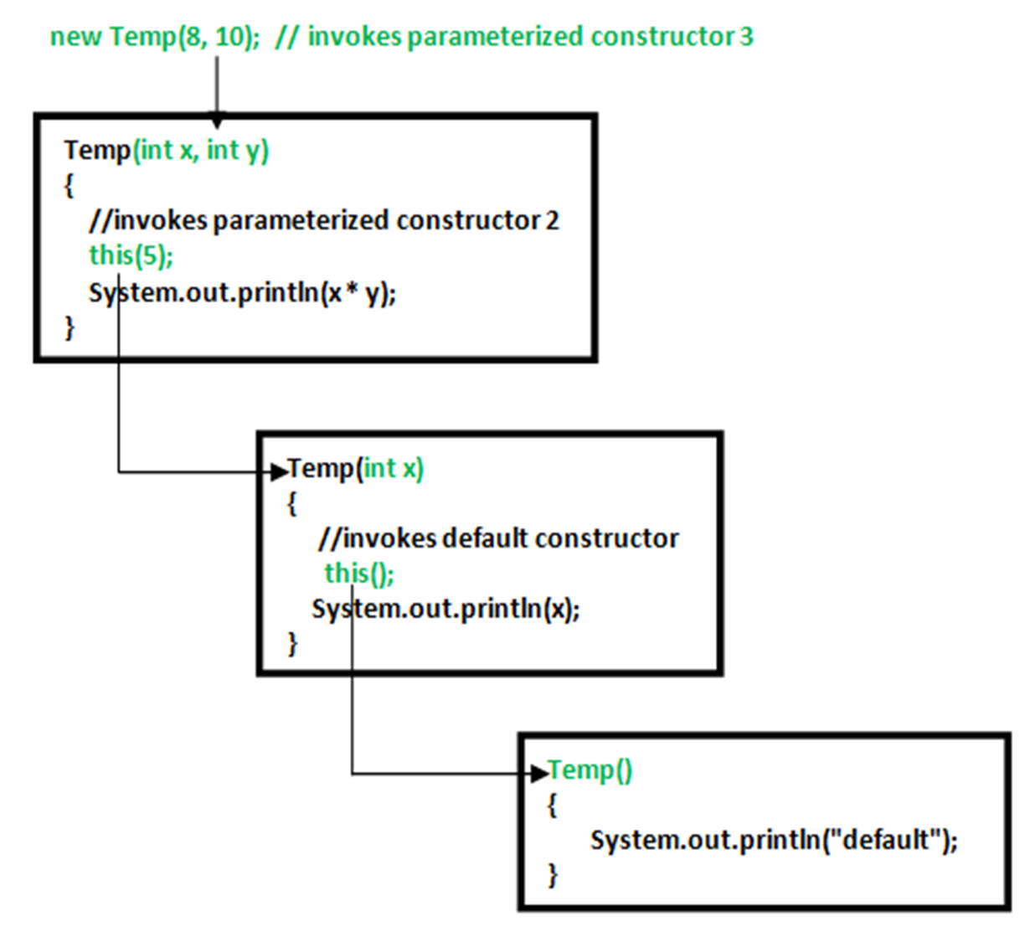
Example:

Slide 12
Predict the output of the following.
1. class Temp {
Temp() {
this(5);
System.out.println("The Default constructor");
}
Temp(int x)
{
this(5, 15);
System.out.println(x);
}
Temp(int x, int y) {
System.out.println(x * y);
}
public static void main(String args[]) {
new Temp();
}
}

Slide 13
2.
class Test {
Test (int w) {
System.out.println(w);
}
static Test () {
System.out.println(10);
}
public static void main (String args[]) {
Test t=new Test(50);
}
}
Can a constructor be static?

